Slide 1




AT82.02
Data Modeling and Management
Unit 1-1: Relational Model concepts
Chutiporn Anutariya (chuti at ait dot ac dot th)

Slide 2
Evolution of data models
least
1960
Hierarchical
Difficult to represent M:N relationships (Hierarchical only)
Physical level dependency
No ad hoc queries
Access path predefined (navigational access)
1969
Network
Semantics in Data Model
Provides ad hoc queries
Set-oriented access
Weak semantic content
1970
Relational
1976
Entity Relationship
Easy to understand
Incorporates more semantics
1976
1978
Semantic
More semantics in data model
Support for complex objects
Inheritance
Behavior
1985
1990
Object-Oriented
Extended Relational (Object/Relational)
most
Address Big Data problem
Less semantics in data model
Based on schema-less key-value data model
Best suited for large sparse data stores
2009
Big Data
NoSQL

Slide 3

RELATIONAL MODEL CONCEPTS
Structure
Constraints
Operations

Slide 4


RELATIONAL MODEL STRUCTURE

Slide 5
The Relational Data Model
Relational model
First commercial implementations available in early 1980s
Has been implemented in a large number of commercial system
Hierarchical and network models
Preceded the relational model

Slide 6
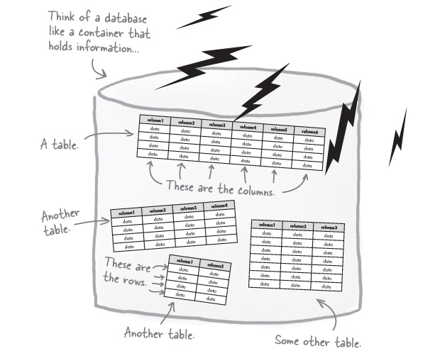
Anatomy of a Database
Database = collection of tables
The information inside the database is organized into tables.

Slide 7
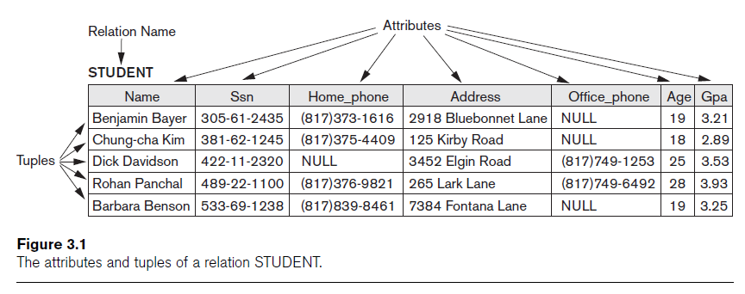
Relational Model Concepts
Table Name
Columns / attributes / properties
Rows / tuples / records

Slide 8
Relation Schema
Relation schema R
Denoted by R(A1, A2, ...,An)
Made up of a relation name R and a list of attributes, A1, A2, ..., An
Attribute Ai
Name of a role played by some domain D in the relation schema R

Slide 9
Example: Relation Schema STUDENT
A relation which stores information about university students, would contain seven attributes describing each student:
STUDENT(Name, Ssn, Home_phone, Address, Office_phone, Age, Gpa)
or (with the data type of each attribute specified)
STUDENT(Name: string, Ssn: string, Home_phone: string, Address: string, Office_phone: string, Age: integer, Gpa: real)

Slide 10
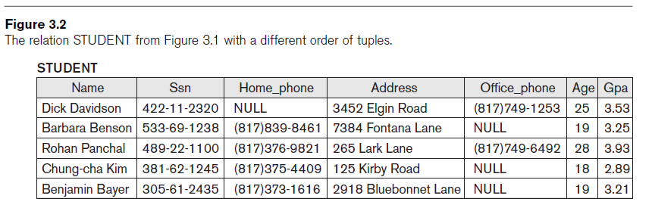
Characteristics of Tables: Order of rows
The order of rows in a table is not important.

Slide 11
Characteristics of Tables: Values
Each value in a row is atomic
Flat relational model
Composite and multivalued attributes not allowed
First normal form assumption
Multivalued attributes
Must be represented by separate relations
Composite attributes
Represented only by simple component attributes in basic relational model

Slide 12
Characteristics of Tables: NULL values
Represent the values of attributes that may be unknown or may not apply to a row
Value unknown
Value exists but is not available
Attribute does not apply to this tuple (aka. value undefined)
Meanings for NULL values

Slide 13
Characteristics of Tables: Meaning
Interpretation (meaning) of a table
Each row in the table is a fact or a particular instance of the assertion

Slide 14

RELATIONAL MODEL CONSTRAINTS

Slide 15
Relational Model Constraints
Constraints
Restrictions on the actual values in a database state
Derived from the rules in the application that the database represents

Slide 16
Relational Model Constraint Categories
Inherent model-based constraints or implicit constraints
Inherent in the data model
The characteristics of relations discussed earlier belong to this category
Ex: The constraint that a relation cannot have duplicate tuples
Schema-based constraints or explicit constraints
Can be directly expressed in schemas of the data model
Ex: Domain constraints, Key constraints, NULL value constraints, etc. (to be discussed next)
Application-based or semantic constraints or business rules
Cannot be directly expressed in schemas
Expressed and enforced by application program

Slide 17
Domain and Data Type Constraints
Domain constraints
Specify that within each row, the value of each column A must be an atomic value from the domain dom(A), such as:
Numeric data types for integers and real numbers
Characters
Booleans
Fixed-length strings
Variable-length strings
Date, time, timestamp
Money
Other special data types

Slide 18

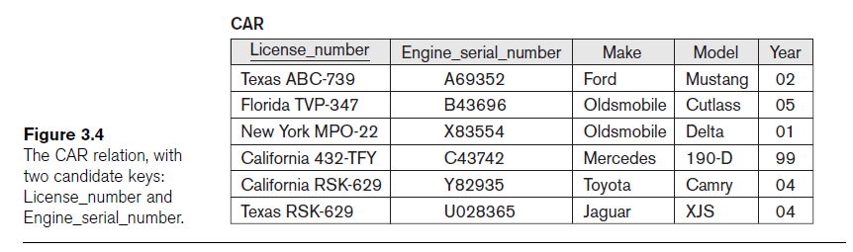
Key Constraints
Two distinct rows in a table cannot have identical values for (all) attributes in key

Slide 19
Key Constraints (cont’d.)
Candidate key
Relation schema may have more than one key
Primary key of the relation
Designated among candidate keys
Underline attribute
Other candidate keys are designated as unique keys

Slide 20
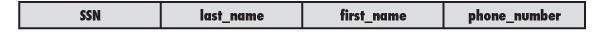
Primary Key Constraints
The primary key is used to uniquely identify each record
Which means that the data in the primary key column can’t be repeated.
Consider a table with the columns shown below. Do you think any of those would make good primary keys?

Slide 21
NULL Value Constraint
A NULL value constraint specifies whether NULL values are or are not permitted.
Example
If every STUDENT row must have a valid, not-NULL value for the Name attribute, then Name of STUDENT is constrained to be NOT NULL.

Slide 22
Referential Integrity / Foreign Key Constraint
Referential integrity (or Foreign Key) constraint
Connecting two tables
Specified between two tables
Maintains consistency among rows in two tables
The FOREIGN KEY (FK) is a column in a table that references the PRIMARY KEY of another table.

Slide 23
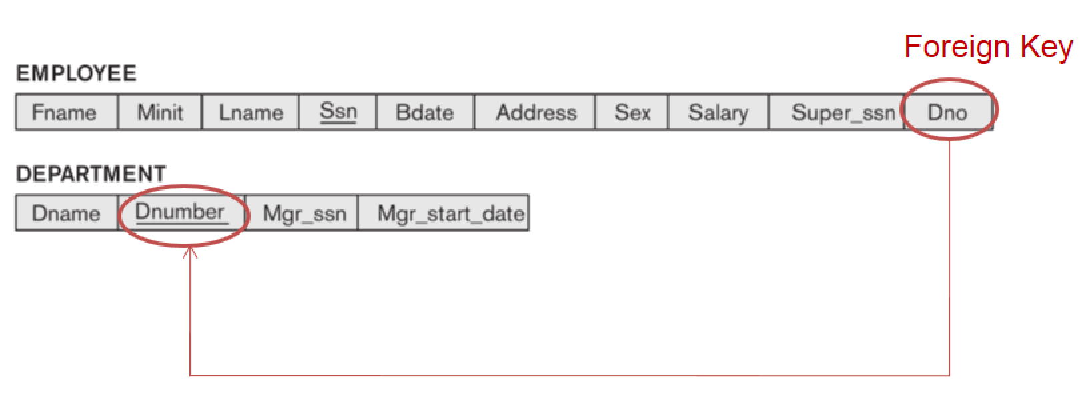
Example
Primary Key

Slide 24
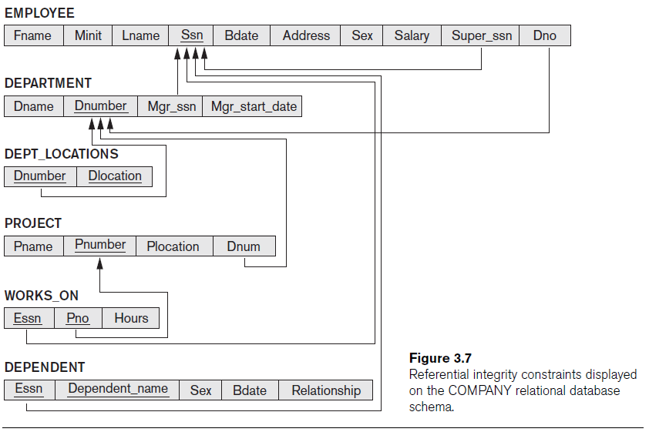
Example: Referential Integrity & Foreign Key Constraints

Slide 25
Operations of Relational Models
Retrieval and Update Operations

Slide 26
Update Operations
Operations of the relational model can be categorized into retrievals and updates
Basic operations that change the states of relations in the database:
Insert
Delete
Update (or Modify)

Slide 27
The Insert Operation
Provides a list of attribute values for a new row to be inserted into a table
Can violate any of the constraints discussed earlier
If an insertion violates one or more constraints
Default option is to reject the insertion

Slide 28
The Delete Operation
Can violate only referential integrity
If the row being deleted is referenced by foreign keys from other row
Restrict
Reject the deletion
Cascade
Propagate the deletion by deleting rows that reference the row that is being deleted
Set null or set default
Modify the referencing attribute values that cause the violation

Slide 29
The Update Operation
Necessary to specify a condition on attributes of relation
Select the row (or rows) to be modified
If attribute not part of a primary key nor of a foreign key
Usually causes no problems
Only need to check that the new values is of the correct data type and domain
Updating a primary/foreign key
Similar issues as with Insert/Delete

Slide 30

SUMMARY

Slide 31
Summary: Relational Model Concepts
Data Structure
Constraints
Operations
Related Tables
Inherent model-based constraints
Explicit schema-based constraints
Application-based constraints
Retrieval
Insert
Delete
Update

Slide 32

Thank you.
Discuss 3 important things / concepts we have learned today.

Slide 33
References
R. Elmasri and S. Navathe: Fundamentals of Database Systems, 7/E, Addison-Wesley, 2015

